Slide 1
TRENDCART SOLUTIONS
Prepared By: Babra Odongo
Data Analyst

Slide 2
Problem Summary
Identifying the most valuable customers is crucial for retention and maximizing revenue.
Analyzing sales trends over time is crucial to determine peak periods, enabling better staffing, inventory management, and operational planning.
Understanding whether customers typically make bulk purchases or smaller frequent orders is vital for optimizing inventory levels and ensuring products are available when needed.
Customer demographics, such as age and gender, are not fully understood, preventing targeted promotions and optimized product offerings.
It is unclear whether customers typically buy in bulk or in small quantities, complicating inventory management and planning.
The business lacks clarity on who the most valuable customers are, making it difficult to prioritize retention and maximize revenue.

Slide 3
Dataset Overview
The TrendCart dataset contains 2000 transactional records across 11 columns, capturing both sales and customer information.
It includes details such as transaction ID, sale date and time, customer demographics (ID, age, gender), product category, quantity, price per unit, cost of goods sold (COGS), and total sale value.
This dataset provides a comprehensive view of customer purchases and product performance, making it suitable for analyzing profitability, sales trends, customer behavior, and product category performance to inform business decisions.

Slide 4
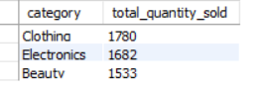
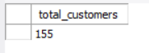
KPIs
Total Sales 908,230
Average Sale per Transaction 457.086059
Total Customers 1987
Unique customers

Slide 5
Data Cleaning
Created cleaned tables or views to ensure consistent and reliable data for analysis.There were no duplicates
Fixed the gender column by converting “M” to “Males” and standardizing other values.
Corrected product category columns for consistency and fixed inconsistent category names
Corrected data types for accurate calculations i.e for dates,
Converted sale_date_text to a proper date column sales_actual_date..Removed the old sale_date_text column to avoid redundancy.
Added sales_year and sales_month columns for improved time-based analysis, along with profit and day columns to support profitability and daily trend insights.

Slide 6
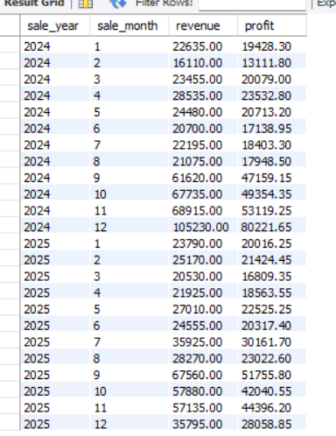
Summary of Findings
The monthly sales data for 2024 and 2025 shows clear seasonal trends, with revenue and profit peaking in September to December each year. December 2024 recorded the highest revenue and profit, indicating strong end-of-year demand, while early months such as January to March consistently show lower performance. Overall, profit closely follows revenue, highlighting that higher sales months directly drive profitability.

Slide 7
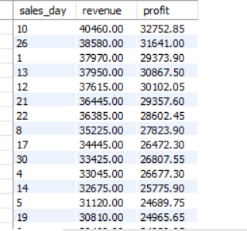
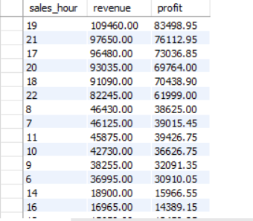
Sales Per Day and Per Hour
Sales peak during evening hours, with hour 19 generating the highest revenue and profit, while hour 23 records the lowest performance. By day, day 10 shows the strongest sales, whereas day 31 has the lowest revenue and profit, indicating reduced activity toward month-end and late-night periods.

Slide 8
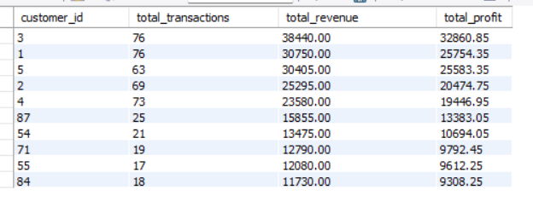
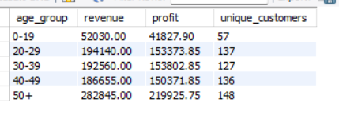
Second point
The analysis of customer transactions reveals that a small group of customers contributes significantly to overall revenue and profit. For example, the top customers recorded between 63 and 76 transactions each, generating revenues ranging from 25,295 to 38,440 and corresponding profits of 20,474 to 32,860. Older customers, especially those aged 50+, generate the highest revenue and profit, while younger age groups contribute less, indicating marketing should target the most valuable age segments.

Slide 9
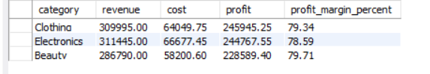
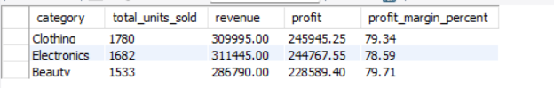
The analysis of product categories shows that Clothing, Electronics, and Beauty are the top-performing categories in both revenue and profit. Electronics generated the highest revenue (311,445) while Clothing had the highest profit (245,945.25), and all three categories maintained strong profit margins around 78–79%. These results indicate that focusing marketing and inventory strategies on these key categories can maximize profitability and sales performance.

Slide 10
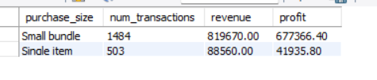

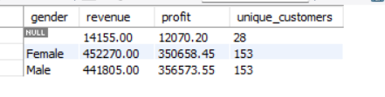
Female customers generated slightly higher revenue, while males delivered marginally higher profit, indicating similar purchasing value. Small bundles drove the highest transaction volume and profit.

Slide 11
Recommendations
Target the most valuable customers—those with the highest transaction counts and revenue—through loyalty programs, personalized offers, and priority support to improve retention and drive repeat purchases.
Align staffing, inventory, and promotional activities with peak months (e.g., September–December) to maximize sales and profit. Introduce off-season promotions to boost performance during slower months like January–March.
Tailor marketing campaigns to high-value age groups, particularly customers aged 50+, who contribute the most revenue and profit. Consider targeted promotions for other profitable segments, such as customers aged 30–49, to increase engagement.
Focus on promoting and expanding bundled offerings through targeted pricing and marketing to boost sales frequency and profitability.
Allocate more marketing and inventory resources to Clothing, Electronics, and Beauty, as they consistently generate the highest revenue and profit. Consolidate minor or duplicate category entries to maintain clean, actionable data.
Continue prioritizing products and categories with strong profit margins, such as Electronics, Clothing, and Beauty. Review lower-margin items and consider adjusting pricing, reducing costs, or discontinuing underperforming products to maximize overall profitability.
Concentrate staffing and promotions around hour 19 and high-performing days such as day 10, while minimizing resources during hour 23 and low-performing days like day 31 to optimize sales and operational efficiency.

Slide 12
The SQL analysis revealed key insights on sales, customer behavior, and product performance, highlighting bundles as top drivers of profit and opportunities to optimize pricing and product strategies for better business performance.

Slide 13

Thanks!

